Slide 1


Exploratory data analysis Project
Majed jamaan alghamdi

Slide 2
index
Introduction
Data Preparation & cleaning
Data Visualization
Conclusion

Slide 3
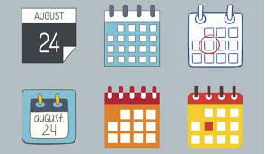
Introduction
The health sector always suffers from the reasons why patients do not comply with their appointments, and they are trying to solve these issues either by examining the quality of the appointment system or knowing what are the motives that make the auditors not adhere to these appointments. In this project I am trying to solve and convince either people or health sector that there is a better choice of appointment system.

Slide 4
Questions came to mind in the first look
What are the factors that affect most on not attending the appointment.
Does the long time between the booking and the appointment day plays an important role.
Is there a difference between men and women's commitment to sick appointments, or do chronic diseases also play an important role?

Slide 5
Data used
In this project, I am using a dataset called Medical Appointment No Shows which was collected from Kaggle website through this link: https://www.kaggle.com/joniarroba/noshowappointments
The data has 13 features and over 110,520 records.
The timeline of the dataset starts from the 10th of November 2015 to the 23rd of June 2016.
The data has a lack of recording accuracy such as some minus values in age, waiting time as well as incorrect feature records that should have been recorded correctly.
I was able to get rid of minus values by set them to zeros where aga and waiting time minimum values are zeros and made sure of my choice is correct by several means.
Some outliers have been corrected by implementing either some statical or constant values.

Slide 6
Answers to my questions
From this analysis I found out that Handicap, SMS received, time until visit, Scholarship, Diabetes are the most effective features that could help when modelling which show a very good separation between the two possible conditions true or false amongst other features.
Gender of the patient has nothing attractive to visit except that women tend to book much more than men.

Slide 7
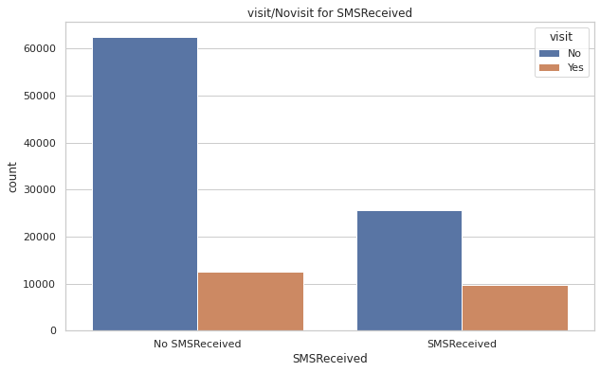
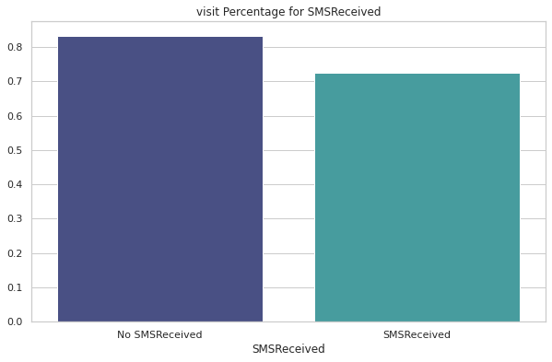
As can be shown the SMS Received has a good indication that people who don't receive the SMS are more likely to not come by a large portion almost 90%. on the other hand, when receiving the SMS have almost 72% and I think the time difference plays a role here as to when receiving the SMS and how close the appointment to the day it was booked. It is one of the good features.

Slide 8
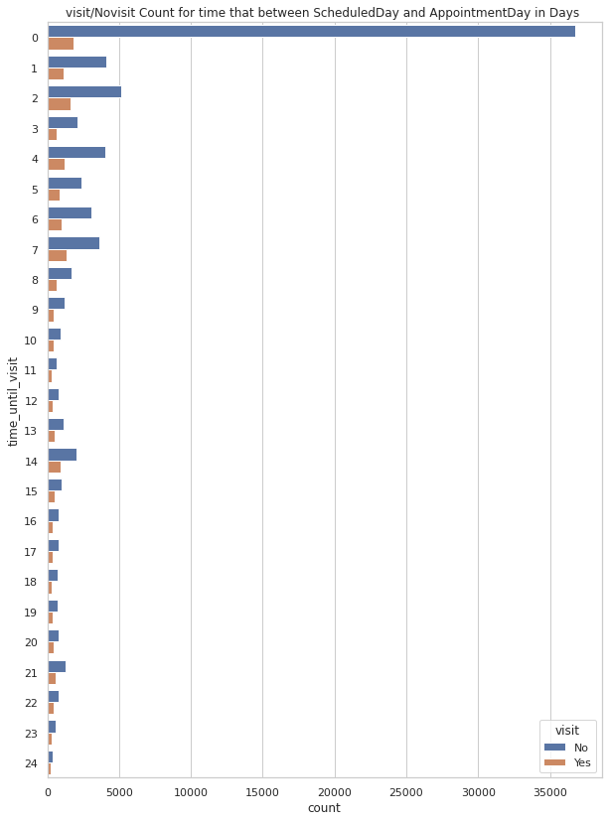
Time difference until visit
Patients who had their appointment in the same day for some reasons didn't come. I think they had to wait for longer time in hours. The longer the time to visit, less numbers of patients would be keen on their appointments.

Slide 9
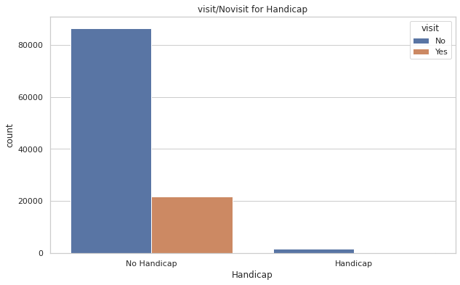
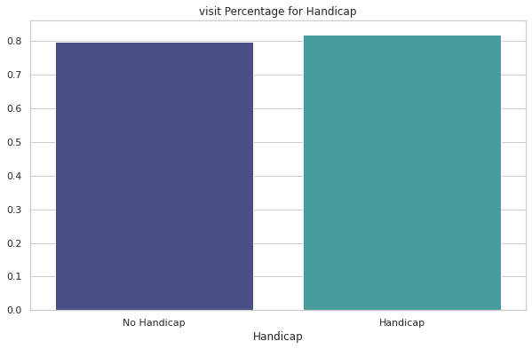
Handicap
Handicap features after editing it with (has Handicap or not) as Boolean; shows that with people with Handicap have higher probability to visit.. good feature too.

Slide 10
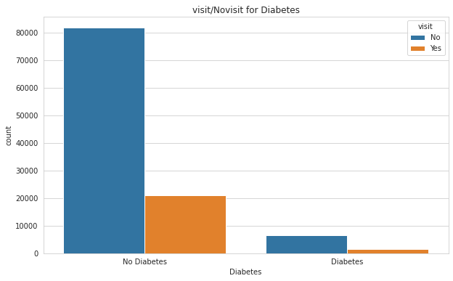
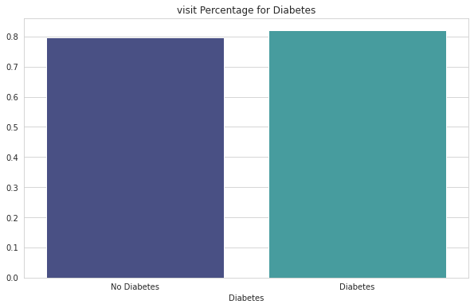
Diabetes
From the above visualization we can see that there are around 80% without Diabetes, have come for the visit.
on the other hand, people with Diabetes around 83% of them have come for the visit.
So, Diabetes feature could be a good feature to use.

Slide 11
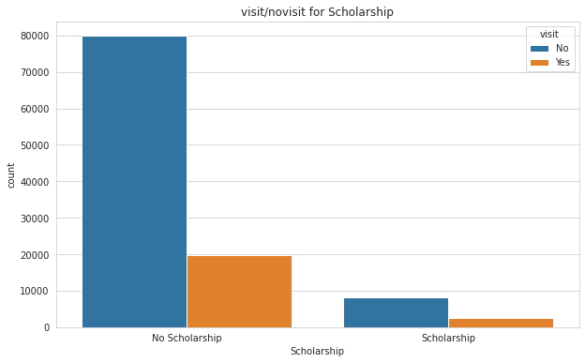
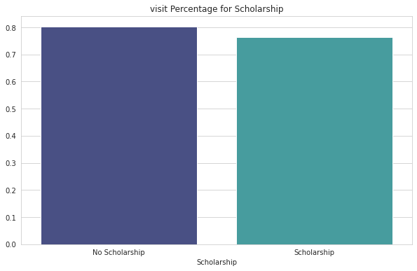
Scholarship
From the graph we can see that there are 80% patients without Scholarshiphave come for the visit.
Around 75% Patients with Scholarship have come for the visit.
So, Scholarship feature could help us in determining if a patient will turn up for the visit after an appointment.

